Slide 1
DEV 1
Fuente +/-
-/+
EDS
RELE 1
NCR
Out.Rele1
Comun
RELE 1
NCR

Slide 2
DEV 1
EDS
1
+/-
RELE 1
NCR
Out.Rele1
0
-/+
Out.Rele2
Comun
RELE 2
NCR

Slide 3
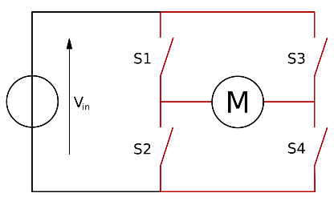
$6.000
Bornera
$10.000
$20.000
$10.000
$10.000
Acoplar IN 12V DC
Regulador/ Swithc
5V
Microcontroller
$10.000

